Slide 1
Global Nitrous Oxide Budget
In partnership with
2020
The GCP is a Global Research Project of
and a Research Partner of
Published on 7 October 2020
PowerPoint version 1.0 (released 7 October 2020)

Slide 2
Acknowledgements
The work presented here has been possible thanks to the enormous observational and modelling efforts of the institutions and networks below
Atmospheric N₂O datasets
NOAA/ESRL | AGAGE | CSIRO
Inventories
FAOSTAT | GAINS | EDGAR 4.3.2 | GFED v4.0
Other sources
SRNM | one nutrient budget model | Mechanistic Stochastic Modeling
Atmospheric inversions
INVICAT | PyVAR |MIROC4-ACTM | GEOSChem
Land models
DLEM | LPJ-GUESS | LPX-Bern | OCN | ORCHIDEE | ORCHIDEE-CNP | VISIT
Ocean models
Bern-3D | NEMOv3.6-PISCESv2-gas | NEMO-PlankTOM10 | UVic2.9 | NEMO-PISCES 3.2
Full acknowledgements provided in Tian et al. (2020) Nature

Slide 3
Contributors 57 people | 48 organisations | 14 countries
Global N₂O Budget - Scientific Steering Committee:
H Tian USA – Co-Chair | RL Thompson Norway – Co-Chair| JG Canadell Australia| W Winiwarter Austria | P Suntharalingam UK | EA Davison USA | M Prather USA | P Ciais France| RB Jackson USA | P Raymonds USA | P Regnier Belgium | G Maenhout Italy | F Zhou China
Contributors:
Rongting Xu USA| Naiqing Pan USA | Shufen Pan USA | Glen P. Peters Norway | Hao Shi USA | Francesco N. Tubiello Italy| Sönke Zaehle Germany| Gianna Battaglia Switzerland| Sarah Berthet France | Laurent Bopp France| Alexander F. Bouwman The Netherlands |
Erik T. Buitenhuis UK | Jinfeng Chang China | Martyn P. Chipperfield UK| Shree R.S. Dangal USA | Edward Dlugokencky USA |
James Elkins USA | Bradley D. Eyre Australia| Bojie Fu China | Bradley Hall USA | Akihiko Ito Japan| Fortunat Joos Switzerland|
Paul B. Krummel Australia | Angela Landolfi Italy| Goulven G. Laruelle Belgium| Ronny Lauerwald France | Wei Li China |
Sebastian Lienert Switzerland | Taylor Maavara USA | Michael MacLeod UK| Dylan B. Millet USA | Stefan Olin Sweden| Prabir K. Patra Japan | Ronald G. Prinn USA | Daniel J. Ruiz USA | Guido R. van der Werf The Netherlands | Nicolas Vuichard France | Junjie Wang China| Ray Weiss USA | Kelley C. Wells USA | Chris Wilson UK | Jia Yang USA | Yuanzhi Yao USA
Hanqin Tian, Rongting Xu, Josep G. Canadell, Rona L. Thompson, Wilfried Winiwarter, Parvadha Suntharalingam, Eric A. Davidson, Philippe Ciais, Robert B. Jackson, Greet Janssens-Maenhout, Michael J. Prather, Pierre Regnier, Naiqing Pan, Shufen Pan, Glen P. Peters, Hao Shi, Francesco N. Tubiello, Sönke Zaehle, Feng Zhou, Almut Arneth, Gianna Battaglia, Sarah Berthet, Laurent Bopp, Alexander F. Bouwman, Erik T. Buitenhuis, Jinfeng Chang, Martyn P. Chipperfield, Shree R.S. Dangal, Edward Dlugokencky, James Elkins, Bradley D. Eyre, Bojie Fu, Bradley Hall, Akihiko Ito, Fortunat Joos , Paul B. Krummel, Angela Landolfi, Goulven G. Laruelle, Ronny Lauerwald, Wei Li, Sebastian Lienert, Taylor Maavara, Michael MacLeod, Dylan B. Millet, Stefan Olin, Prabir K. Patra, Ronald G. Prinn, Peter A. Raymond, Daniel J. Ruiz, Guido R. van der Werf, Nicolas Vuichard, Junjie Wang, Ray Weiss, Kelley C. Wells, Chris Wilson, Jia Yang, Yuanzhi Yao (2020) A comprehensive quantification of global nitrous oxide sources and sinks, Nature, 7 October 2020

Slide 4
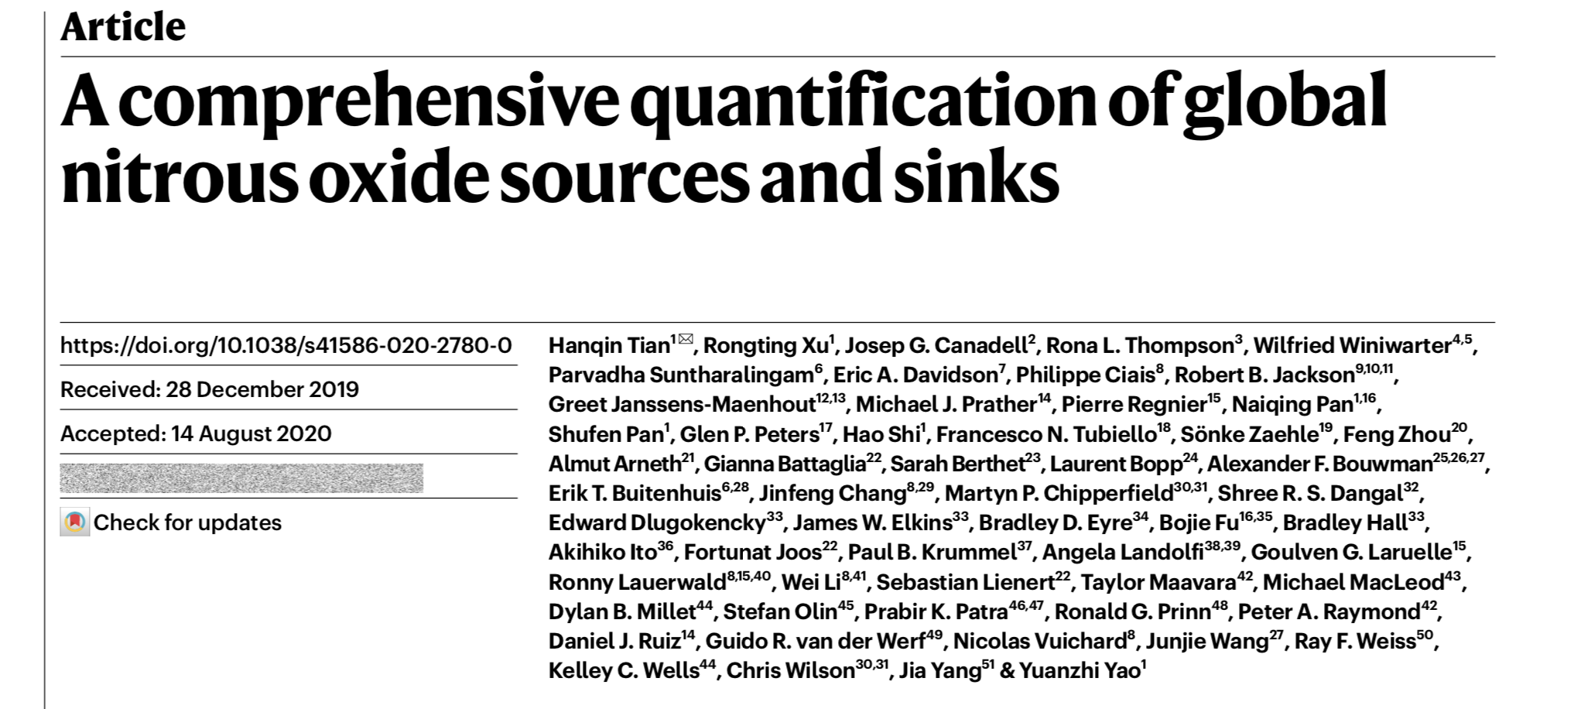
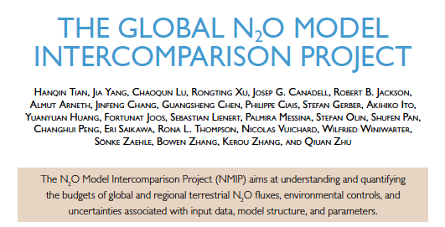
Publications of the Global N₂O Budget Activity
https://doi.org/10.1038/s41558-019-0613-7
https://doi.org/10.1038/s41586-020-2780-0
https://doi.org/10.1175/BAMS-D-17-0212.1

Slide 5
Emissions are shown in Mega tonnes N
1 Megatonne (Mt) = 1 million tonnes = 1×10¹²g = 1 Teragram (Tg)
1 kg nitrogen in nitrous oxide (N) = 1.57 kg nitrous oxide (N₂O)
1 MtN = 1.57 million tonnes N₂O = 1.57 MtN₂O
Disclaimer
The Global Carbon Budget and the information presented here are intended for those interested in learning about the carbon cycle, and how human activities are changing it. The information contained herein is provided as a public service, with the understanding that the Global Carbon Project team make no warranties, either expressed or implied, concerning the accuracy, completeness, reliability, or suitability of the information.

Slide 6
N₂O Basics
N₂O is both a powerful greenhouse gas (GHG) and a ozone-depleting substance.
Per unit of mass, N₂O is considered 298 times as effective as a greenhouse gas as CO₂ when integrating over 100-years.
Once emitted, N₂O stays in the atmosphere for longer than a human life, about 116 ±9 years.
N₂O is the third most important GHG contributing to human-induced global warming, after carbon dioxide (CO₂) and methane (CH₄).
N₂O is responsible for 6.5% of the global warming due to three most important GHGs (CO₂, CH₄ and N₂O) (Updated to 2019 from Etminan et al. 2016, GRL)
N₂O concentration in the atmosphere reached 331 parts per billion (ppb) in 2018 (WMO 2020, United in Science), about 22% above levels around the year 1750, before the industrial era began.

Slide 7
Highlights
Global N₂O emissions were about 17.0 (15.9–17.7) Tg N yr⁻¹ over the 10-year period 2007-2016 (based on two approaches).
Global anthropogenic emissions increased by 30% since 1980, dominated by nitrogen fertilization in croplands. The anthropogenic emission increase is almost exclusively responsible for the growth in atmospheric N₂O.
Soil N₂O emissions are increasing due to interactions between nitrogen inputs and global warming, constituting an emerging positive N₂O-climate feedback.
The recent increase in global N₂O emissions exceeds the emission trends of the least optimistic scenarios developed by the Intergovernmental Panel on Climate Change (IPCC), underscoring the urgent need to mitigate N₂O emissions.

Slide 8
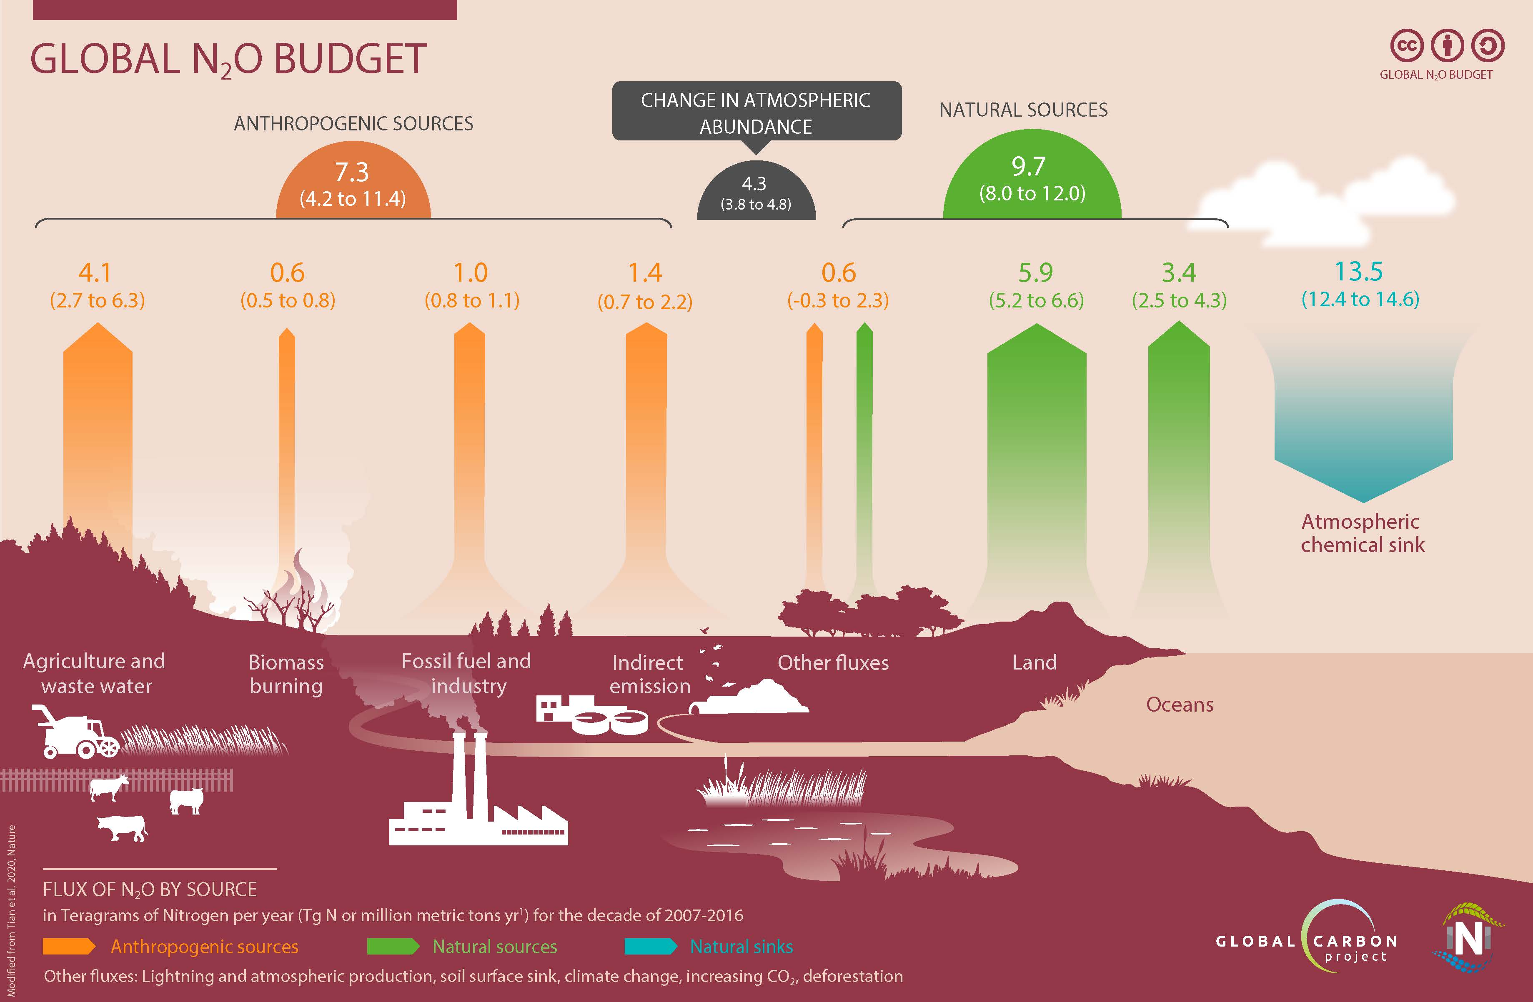
The Global N₂O Budget (simplified)
Anthropogenic sources contribute, for the central estimate, 43% to total global N₂O emissions.

Slide 9
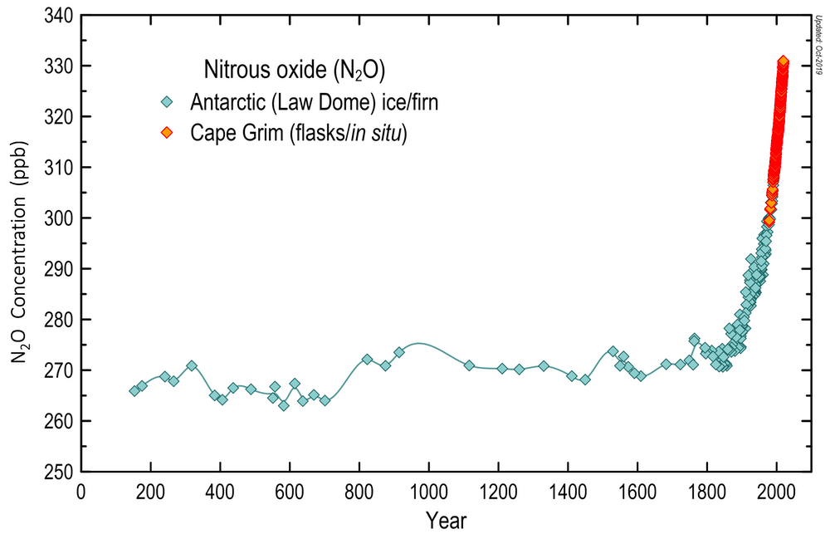
Atmospheric N₂O concentrations over the last two millennia
The global N₂O concentration has increased by about 22%, from 270 parts per billion (ppb) in 1750 to 331 ppb in 2018.
Source: BoM/CSIRO/AAD

Slide 10
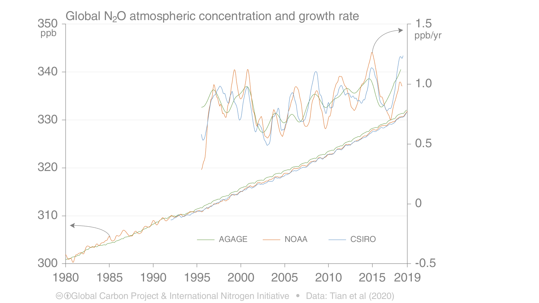
Atmospheric concentration and growth rate over the last 40 years
The growth in global atmospheric N₂O is accelerating The mean growth rate since 2000 is 0.84 ppb/yr

Slide 11
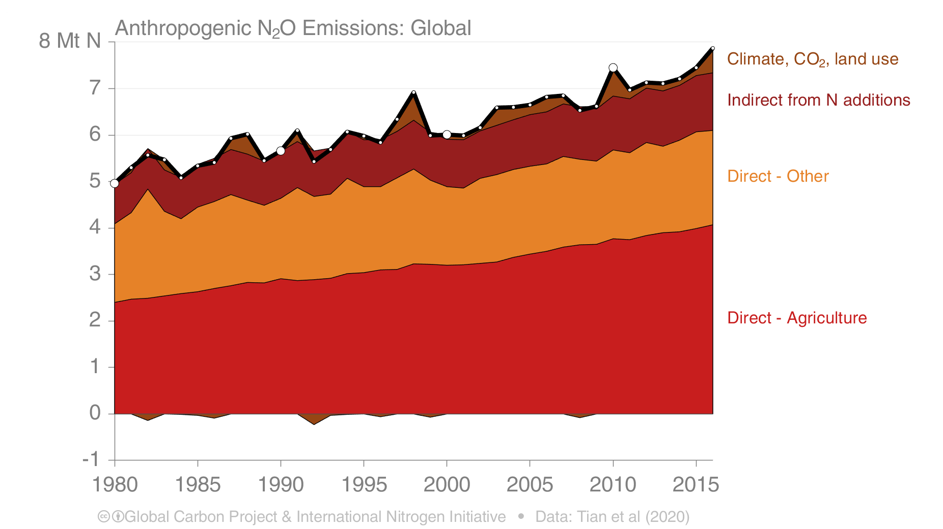
Global Anthropogenic N₂O Emissions
Global anthropogenic N₂O emissions are growing at over 1% pear year. Agriculture is the single largest anthropogenic source of N₂O emissions.
(industry, fossil fuels, others)
Direct sources are those occurring where nitrogen additions are made, while indirect sources are those occurring down-stream or downwind

Slide 12
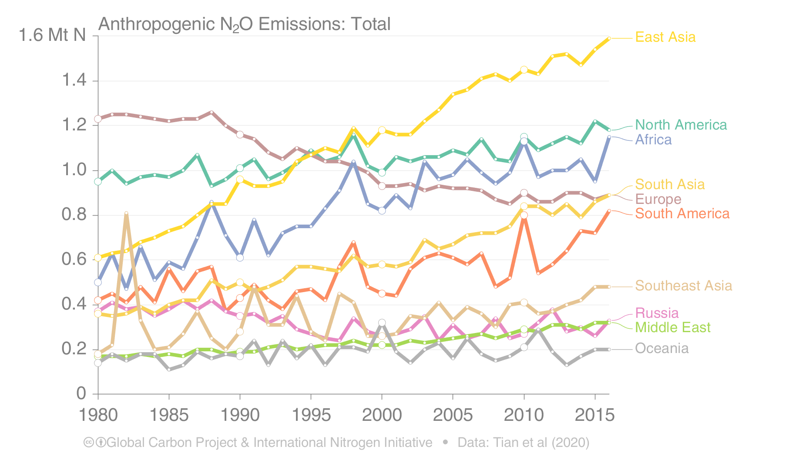
Anthropogenic Emissions by World Region
The recent global increase in N₂O emissions is driven by Asia, followed by South America and Africa, while emissions in Europe have decreased since 1990

Slide 13
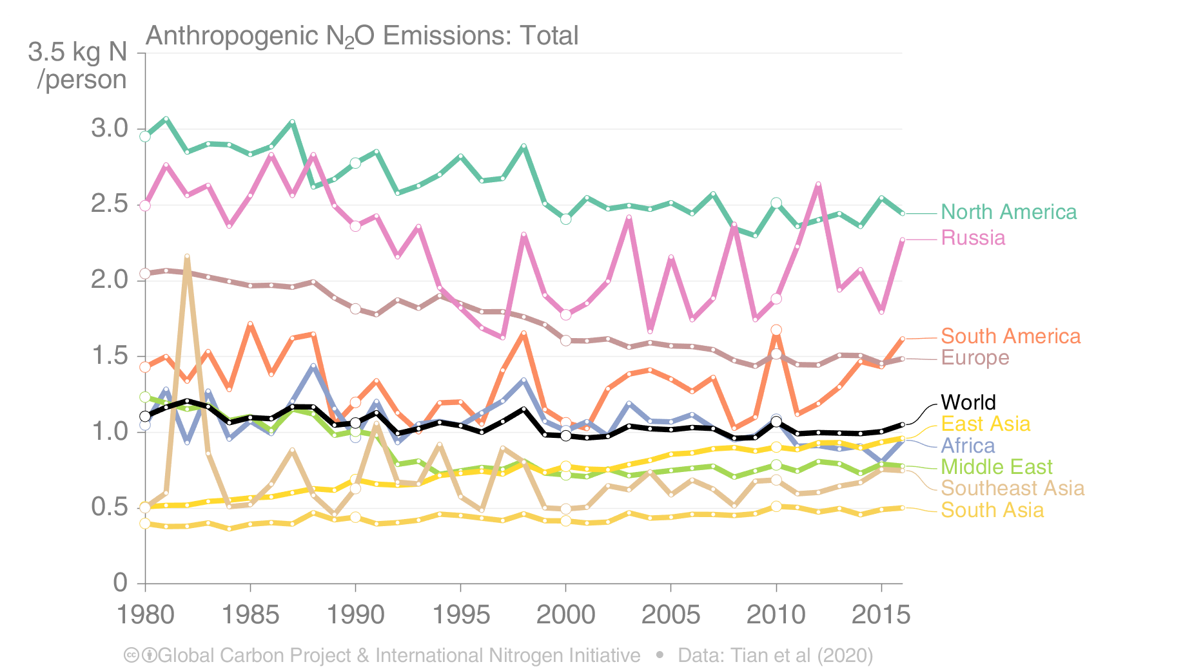
Anthropogenic Emissions per Person by World Region
There is a broad range of N₂O emissions per person, with wealthier regions generally above the world average
Oceania excluded to make figure clearer. Oceania emits around 6kgN per person

Slide 14
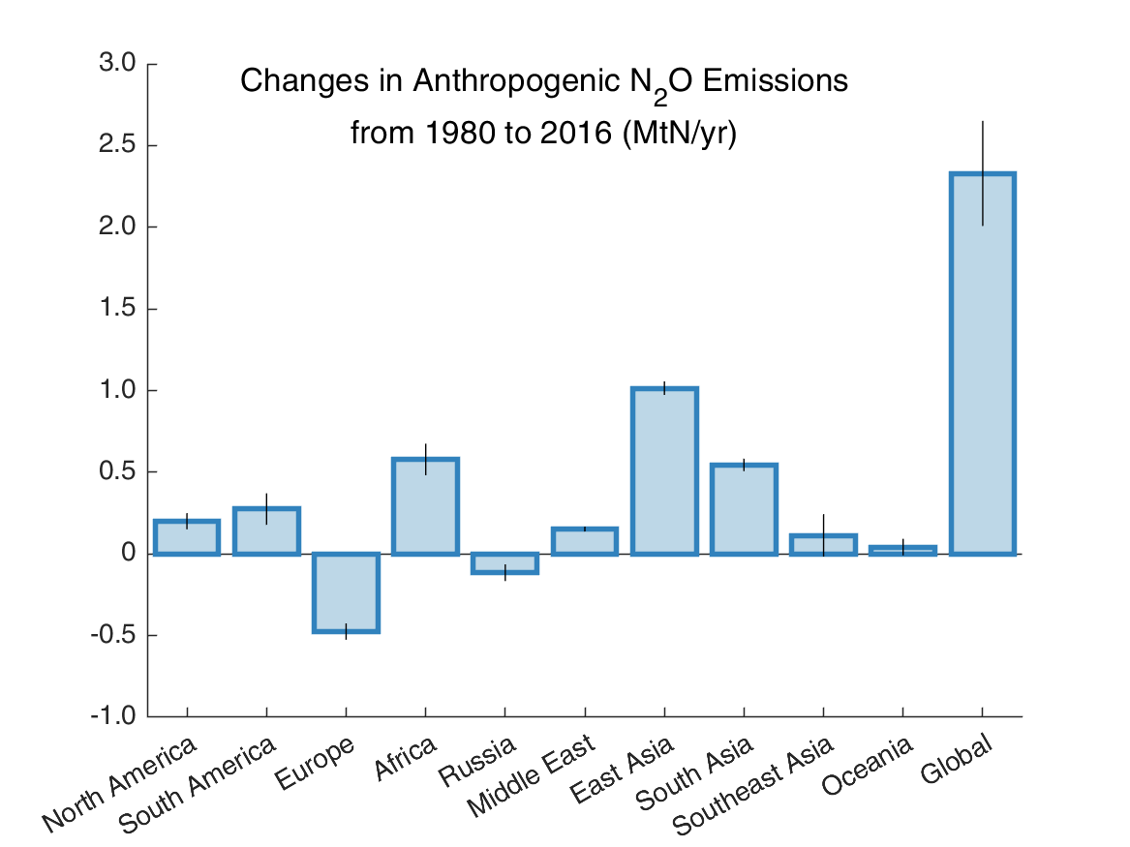
Changes in anthropogenic N₂O emissions
Emissions from Europe and Russia decreased by a total of 0.6 (0.5−0.7) TgN/yr over 1980-2016, while emissions from the remaining regions increased by a total of 2.9 (2.4−3.4) TgN/yr
Source: Tian et al. 2020, Nature
Source: Tian et al. 2020, Nature

Slide 15
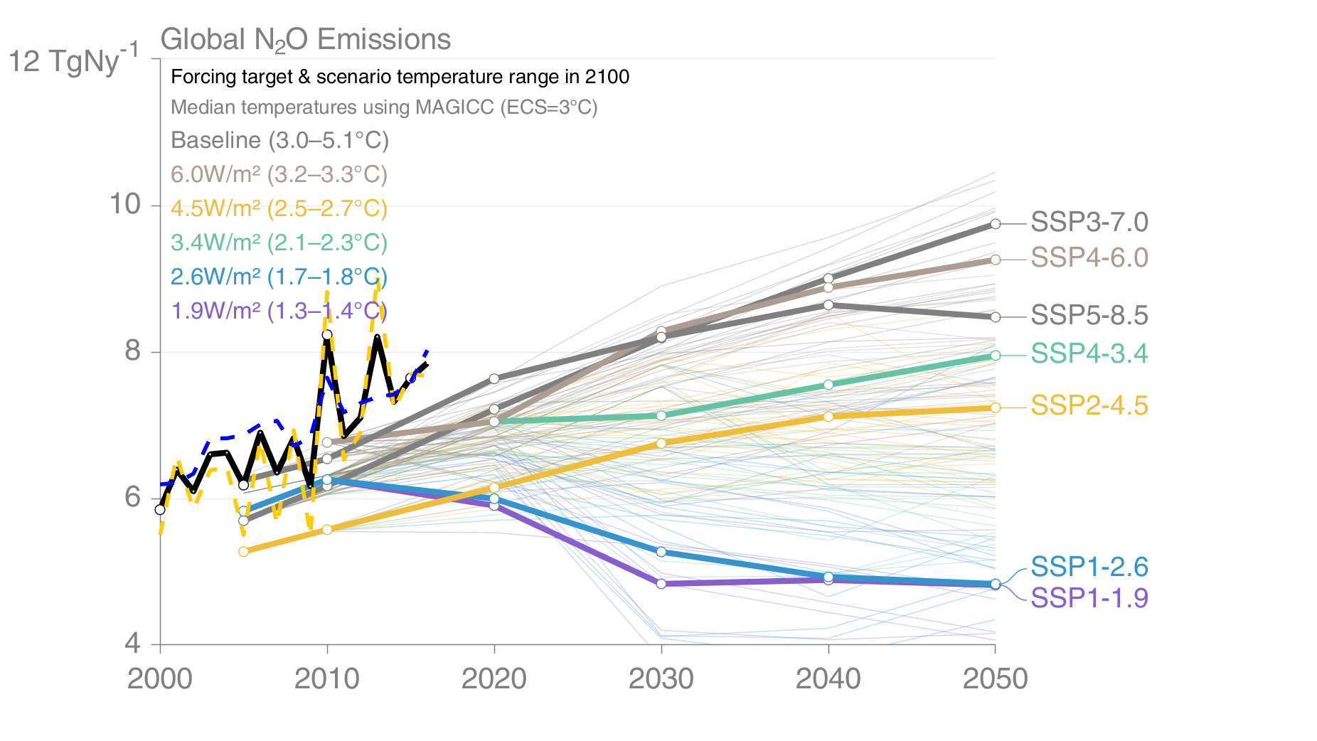
Shared Socioeconomic Pathways (SSPs)
The SSPs lead to a broad range in baselines (grey), with more aggressive mitigation leading to lower temperature outcomes. The bold lines are scenarios that will be analysed in CMIP6 and the results assessed in the IPCC AR6 process.
The bold black and dashed blue and yellow lines are the estimated actual emissions
Historical emissions
This set of quantified SSPs are based on the output of six Integrated Assessment Models (AIM/CGE, GCAM, IMAGE, MESSAGE, REMIND, WITCH). Model and Data Sources: Riahi et al. 2016; Rogelj et al. 2018; IIASA SSP Database; IAMC; Global Carbon Budget 2019

Slide 16
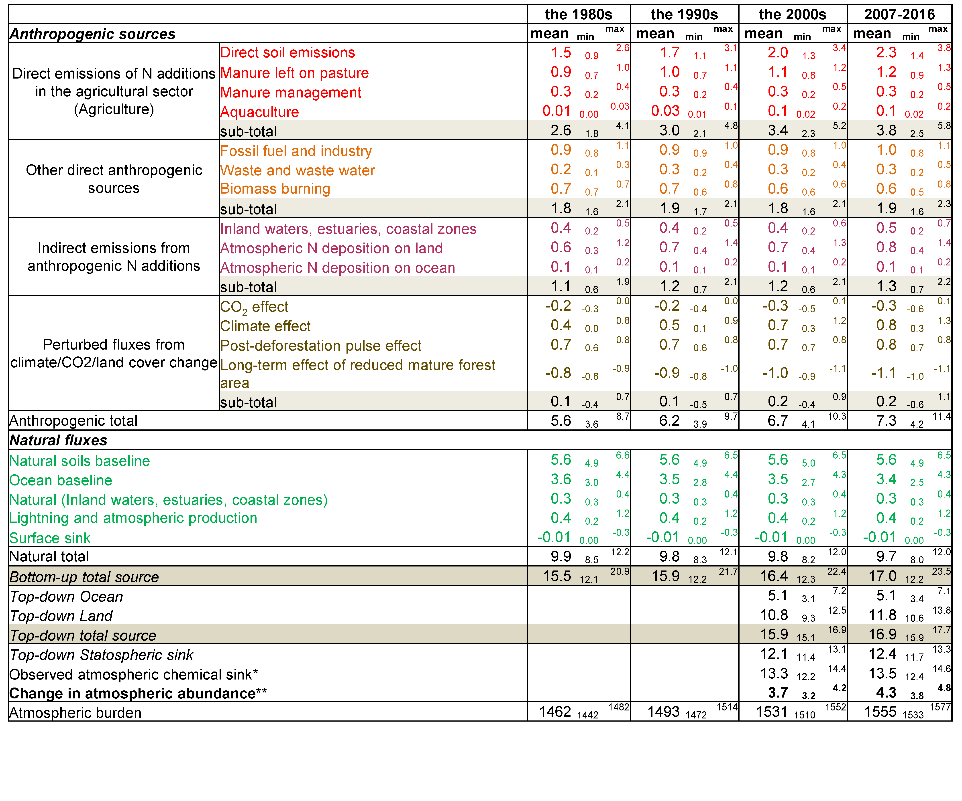
Global N₂O sources and sinks in the past four decades
The budget includes 21 natural and anthropogenic source categories. Global N₂O emissions have increased significantly since the 1980s, driven primarily by anthropogenic sources.

Slide 17
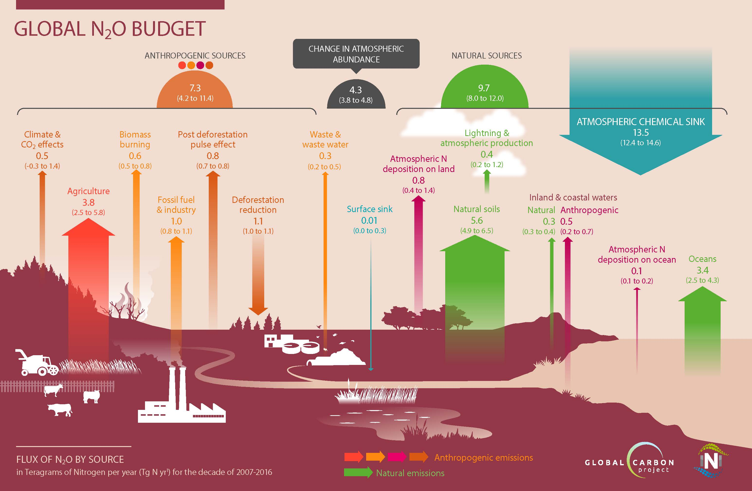
Global N₂O Budget (complete)
Source: Tian et al. 2020, Nature

Slide 18
Methodology overview
The global N₂O budget is synthesized from 43 independent estimates, including emission inventories, process-based and empirical models (so-called “bottom-up” estimates) and atmospheric measurements and modeling (so-called “top-down” estimates).
Process-based models were used for estimates of emissions from agriculture and land-use change, as well as natural emissions from soils, inland waters, and ocean.
Process-based models were used to determine the interactions between nitrogen additions and climate and derived a positive N₂O-climate feedback.
Empirical models were used for estimates of emissions from agriculture, waste, fossil fuel combustion, industry, biomass burning and aqua-culture.
Measurements of atmospheric N₂O were used in statistical models to optimize independent emissions estimates (the so-called “atmospheric inversion” approach). This approach estimates the sum of N₂O sources over land and ocean.
Atmospheric chemistry transport models were used to estimate the stratospheric sink of N₂O

Slide 19
Key uncertainties
Current data analysis and synthesis of long-term N₂O fluxes are based on a wide variety of top-down and bottom-up approaches.
Top-down approaches provide a range of estimates, due to systematic errors in the modelled atmospheric transport and stratospheric loss of N₂O, as well as large uncertainty in prior ocean flux estimates.
Bottom-up approaches are subject to large uncertainties in various sources from land and oceans. For process-based land and ocean models, the uncertainty is associated with differences in model configuration as well as process parameterization.
GHG inventories using default Emission Factors show large uncertainties at the global scale, especially for agricultural N₂O emissions due to the spatial divergence in climate, management, and soil conditions.
A large range of Emission Factors have been used to estimate aquaculture N₂O emissions and long-term estimates of N flows in freshwater and marine aquaculture are scarce.
Missing fluxes from permafrost thawing and the freeze-thaw.
The relative proportion of ocean N₂O from oxygen-minimum zones, Oxic versus sub-oxic ocean zones, is highly uncertain.

Slide 20
Emissions from key regions

Slide 21
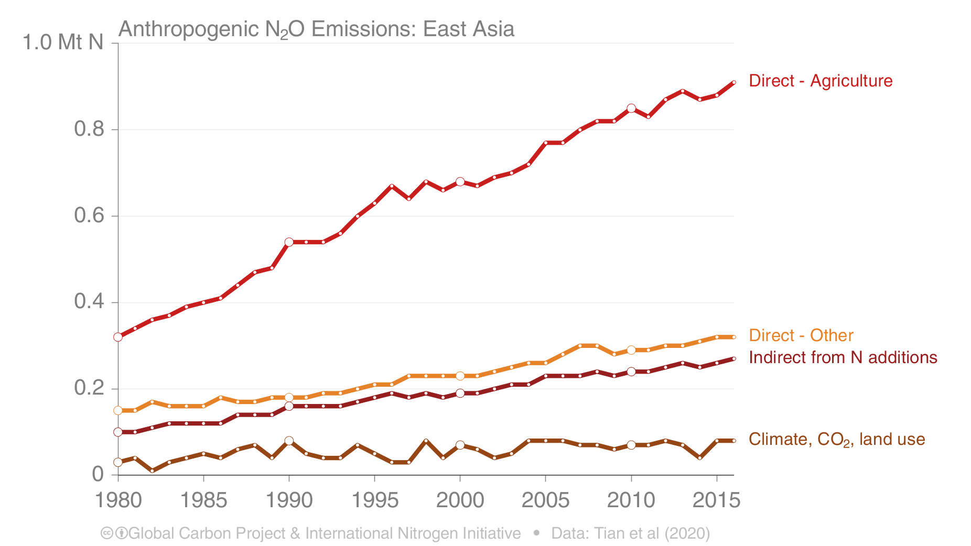
East Asia: Anthropogenic N₂O Emissions

Slide 22
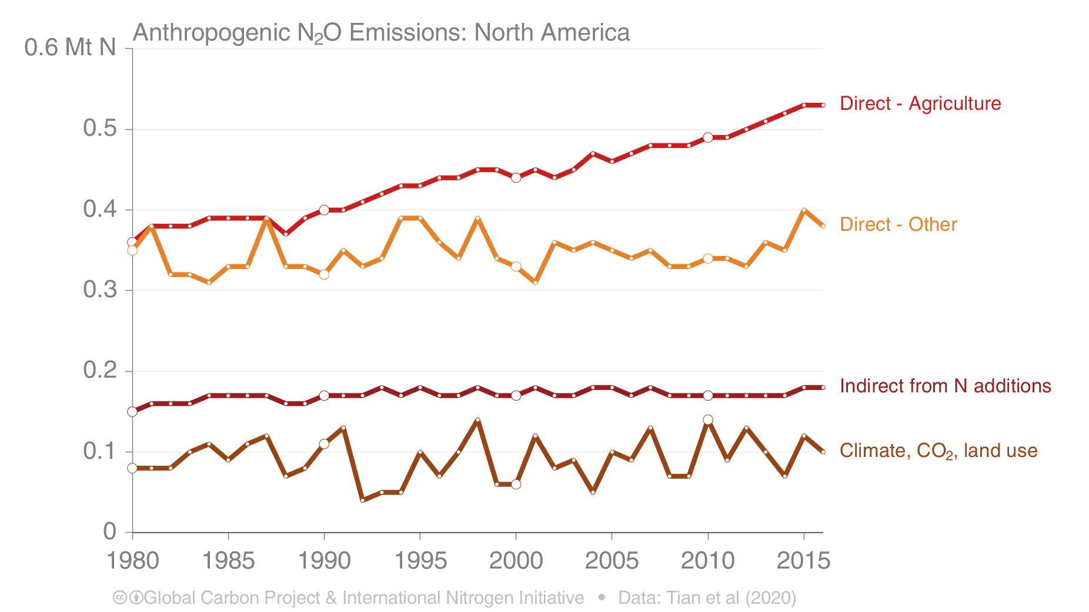
North America: Anthropogenic N₂O Emissions

Slide 23
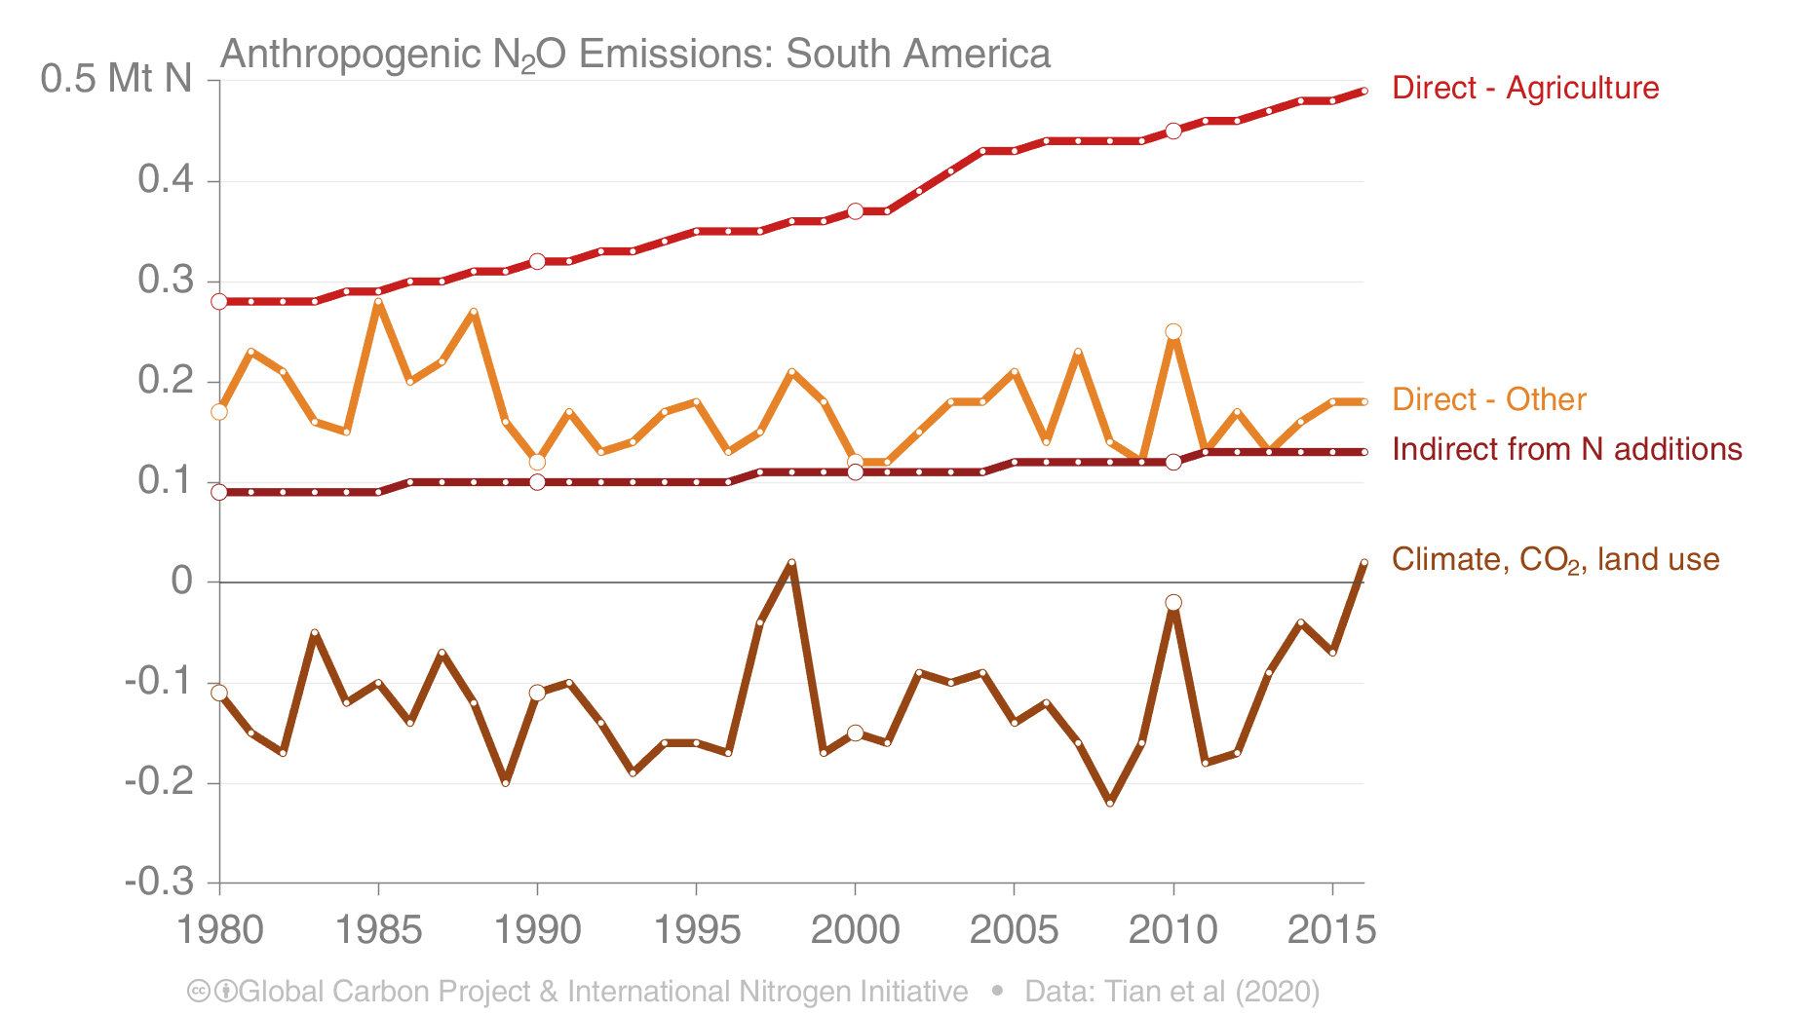
South America: Anthropogenic N₂O Emissions

Slide 24
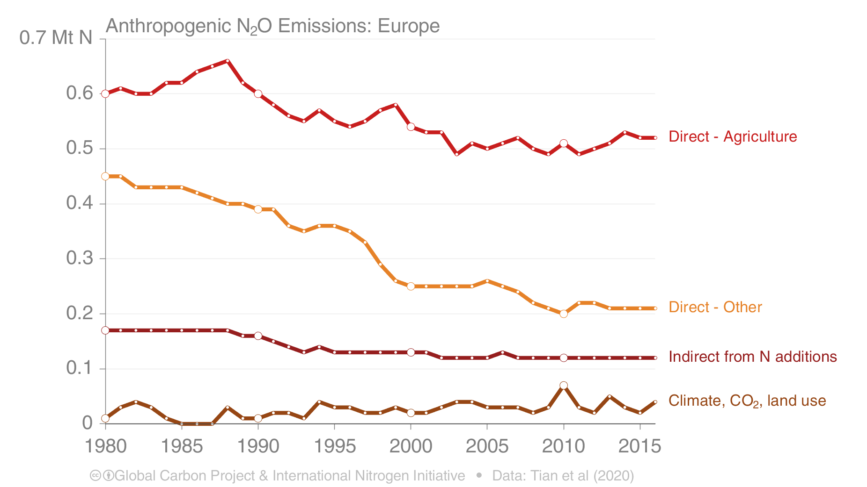
Europe: Anthropogenic N₂O Emissions

Slide 25
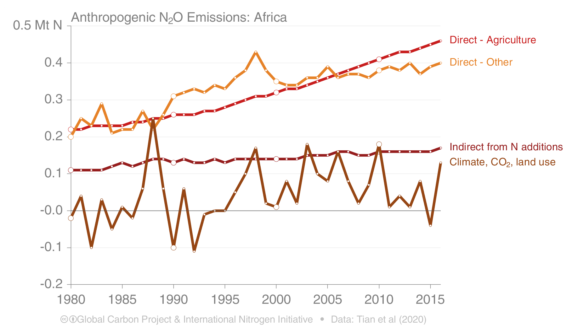
Africa: Anthropogenic N₂O Emissions

Slide 26
Additional figures

Slide 27
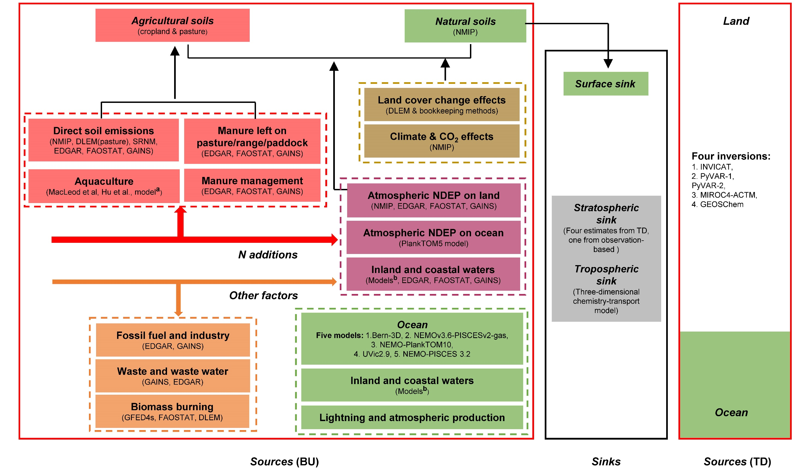
The methodology for preparing the N₂O budget
The global N₂O budget is synthesized from 43 independent estimates
(Bottom-up (BU) are from statistical and process-based models, Top-down (TD) are derived from atmospheric observations)
Source: Tian et al. 2020, Nature
ªMacLeod et al. and Hu et al. provide global aquaculture N₂O emissions in 2013 and in 2009, respectively; and the nutrient budget model provides N flows in global freshwater and marine aquaculture over the period 1980−2016. ^{b}Model-based estimates of N₂O emissions from ‘Inland and coastal waters’ include rivers and reservoirs, lakes, estuaries, coastal zones (i.e., seagrasses, mangroves, saltmarsh and intertidal saltmarsh), and coastal upwelling.

Slide 28
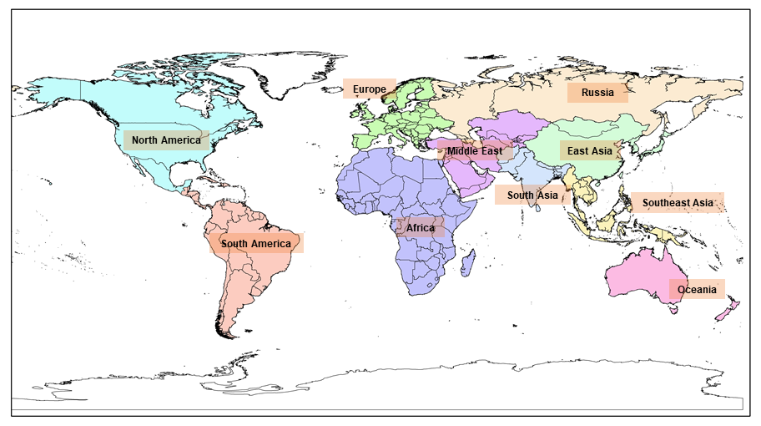
Ten study regions for regional N₂O budgets
The Earth’s ice-free land was partitioned into ten regions
Source: Tian et al. 2020, Nature

Slide 29
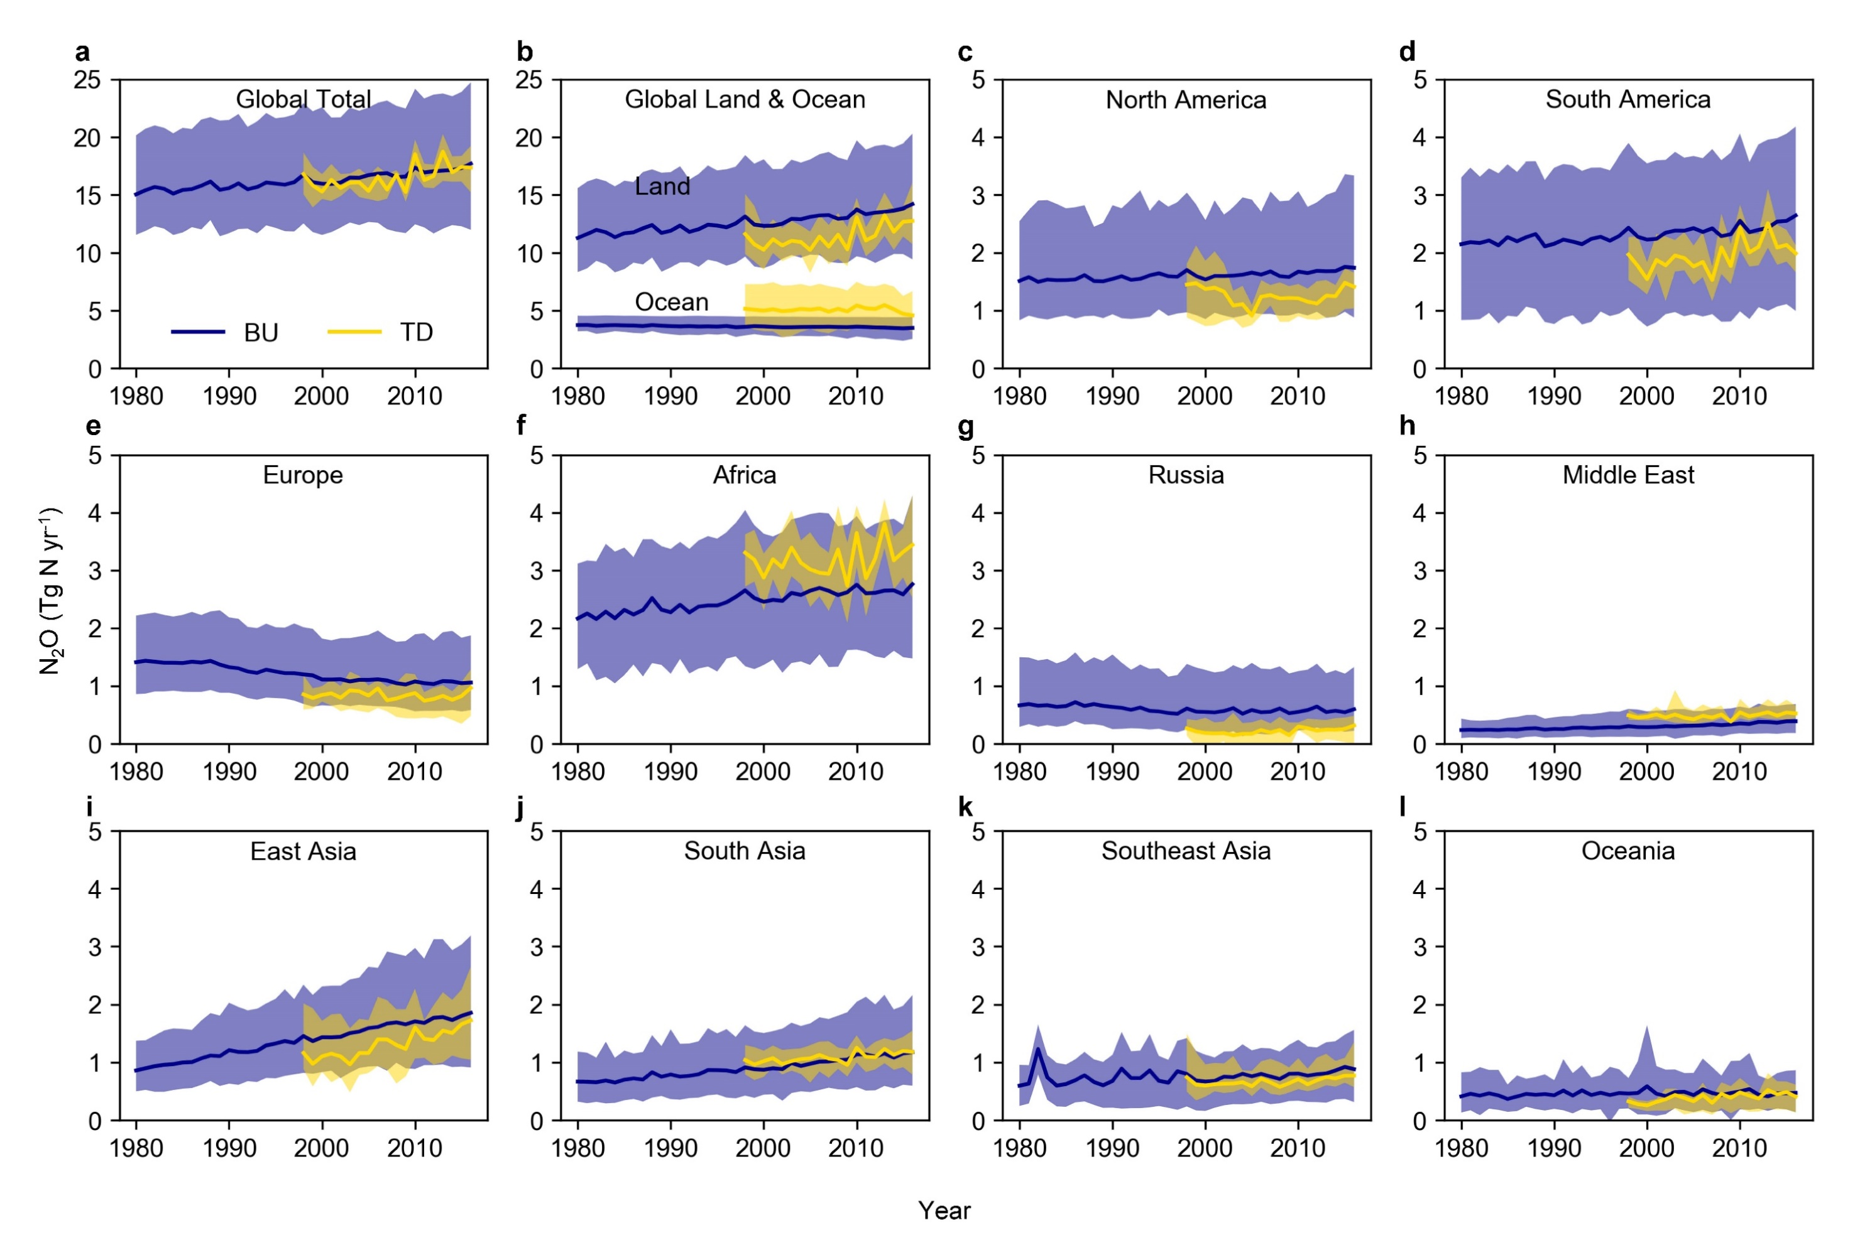
Annual comparison of Bottom-Up (BU) and Top-Down (TD) estimates
Global N₂O emission estimates from BU and TD are comparable in magnitude and trend for 1998-2016. TD estimates show larger inter-annual variability but have smaller land and larger ocean emissions.
Source: Tian et al. 2020, Nature

Slide 30
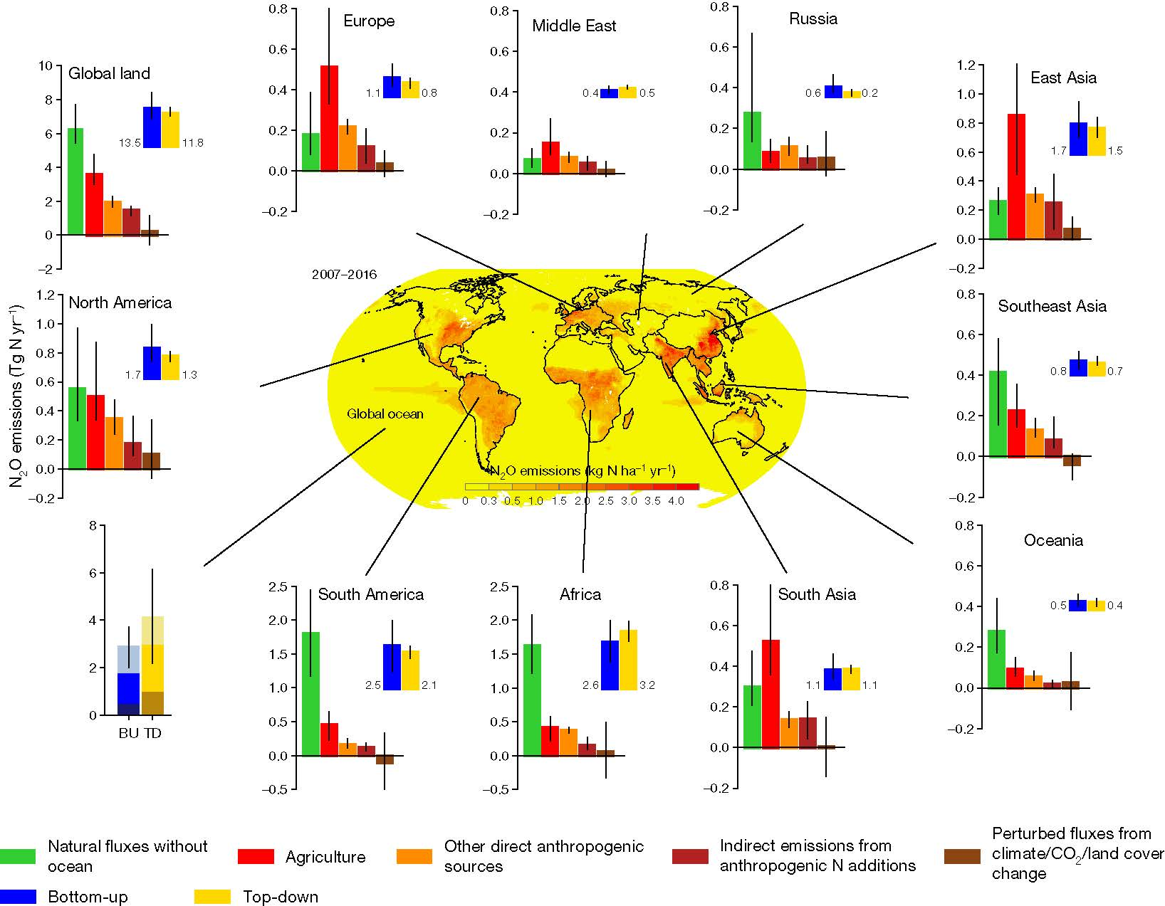
Regional N₂O Budgets for 2007-2016
Bottom-up and top-down approaches indicate that Africa was the largest N₂O land source in the last decade, followed by South America. The tropical oceans contribute over 50% to the global oceanic source.
Source: Tian et al. 2020, Nature

Slide 31
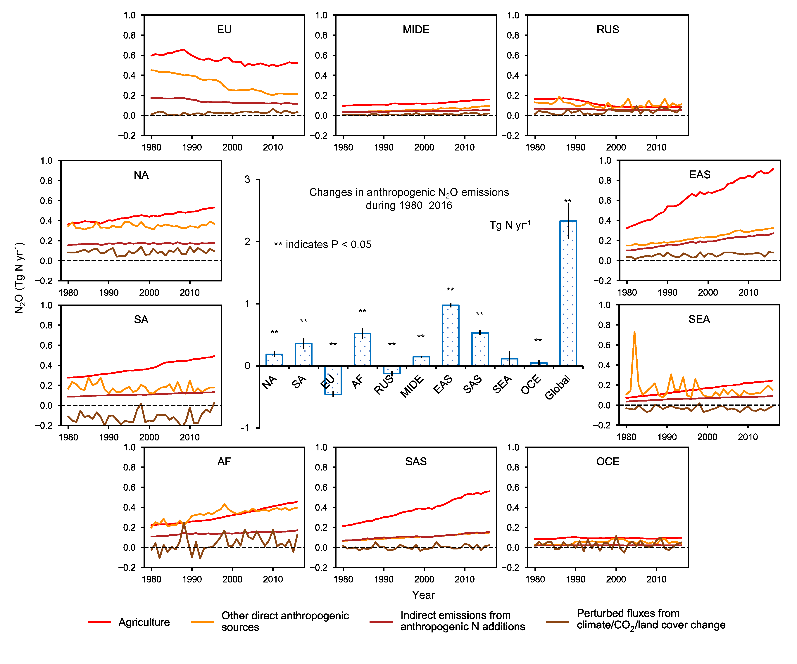
Regional trends in anthropogenic N₂O emissions
Europe
Middle East
Russia
North America
East Asia
South America
Southeast Asia
Africa
South Asia
Oceania
Source: Tian et al. 2020, Nature

Slide 32
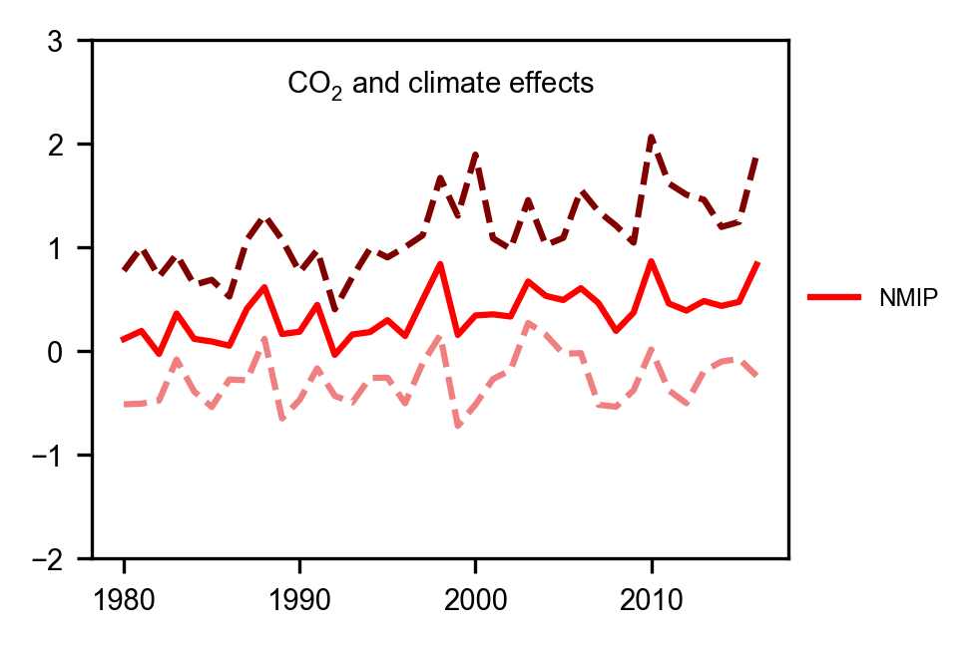
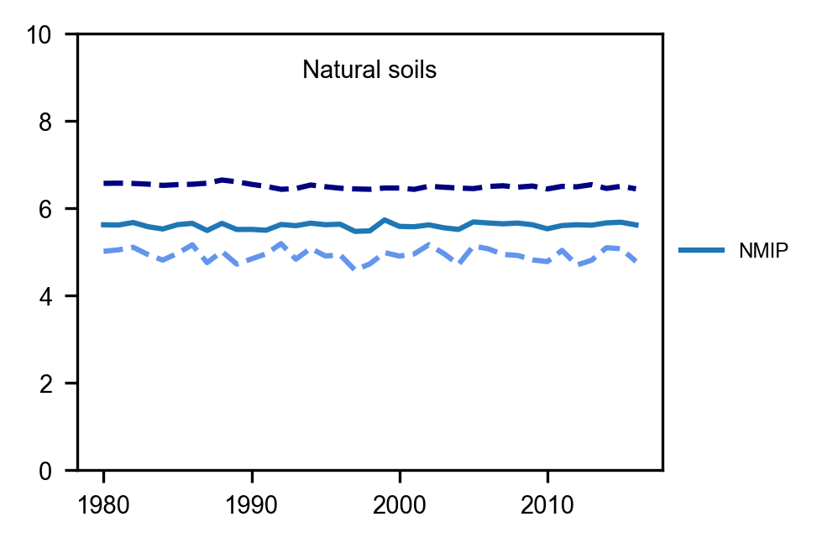
Estimates of CO₂, climate, & soil effects
A large inter-annual N₂O variability is attributable to the effect of environmental factors (i.e., climate).
a
b
N₂O (Tg N yr⁻¹)
NMIP-Max
NMIP-Max
NMIP-Mean
NMIP-Mean
NMIP-Min
NMIP-Min
Source: Modified from Tian et al. 2020, Nature
Results from six terrestrial biosphere models (Global N₂O Model Intercomparison Project, NMIP)
a) change in global land N₂O emissions due to CO₂ and climate effects, b) variability in global natural soil N₂O emissions. (Note: global natural soil N₂O emissions were defined as without consideration of land use change (e.g., deforestation) and without consideration of indirect anthropogenic effects via global change (i.e., climate, elevated CO₂, and atmospheric N deposition)

Slide 33
Climate effects based on terrestrial biosphere model simulations
Process-based model estimates show that soil N₂O emissions increased substantially due to climate change since the early 1980s constituting a positive nitrogen-climate feedback.
Climate only
N₂O emission anomaly (Tg N yr⁻¹)
Temperature anomaly (°C)
N₂O (Tg N yr⁻¹)
All factors included
Source: Modified from Tian et al. 2020, Nature

Slide 34
Changes in natural N₂O emissions from global deforestation
The global net effect of deforestation is first an increase and then gradually a reduction of N₂O emissions, reaching -0.34 ± 0.11 TgN/yr in 2016.
(Note: changes in crop/pasture emissions are calculated in the absence of N-fertilizer and manure use, when this is considered the crop/pasture emissions are significantly higher and the net N₂O change is positive)
Source: Tian et al. 2020, Nature

Slide 35
Direct soil emissions and agricultural product trades in Brazil
Agricultural N₂O emissions for Brazil increased by 120% from 1980 to 2016 due to increases in livestock and N-fertilizer use
Source: Tian et al. 2020, Nature
In (a), the red line shows the direct N₂O emissions from livestock manure based on EDGARv4.3.2, GAINS, and FAOSTAT (the sum of ‘manure left on pasture’ and ‘manure management’). The gray columns show the amount of beef exported by Brazil. In (b), the orange line shows the direct N₂O emissions from croplands due to N-fertilization based on NMIP and SRNM. The gray columns show the amount of soybean and corn exported by Brazil.

